Slide 1
NAME-338 Ship Design Project & Presentation
Supervised by,
Dr. N. M. Golam Zakaria
Professor,
Dept. of NAME,
BUET.
Presented by,
Touseef Hasan
Student ID: 1812044,
Mehedi Hasan
Student ID: 1712046.

Slide 2
Owner’s Requirements
Vessel Type: Bulk Carrier
Capacity: 2300 tonnes
Service Speed: 10 knots
Route: Dhaka – Chittagong (Inland)
Route Distance: 315 km (171 nautical miles)

Slide 3
Principal Particulars
Length Overall
Length between Perpendiculars
Breadth Mld.
Depth Mld.
Draft
Service Speed
CB
: 76.4 m
: 74.4 m
: 13.54 m
: 5.1 m
: 3.85 m
: 10 knots
: 0.79

Slide 4
List of Contents
Detailed Weight Calculation
Approximate Trim and Stability Calculation
Resistance and Power Calculation
Rudder Design & Steering Arrangement
Propeller Design
Engine Selection & Design of Engine Foundation

Slide 5
Detailed Weight Calculation
 | Item | Weight (tonnes) | LCG (m) | Moment (t-m) (about aft) | VCG (m) | Moment (t-m) (about keel)
1 | Steel Weight | 640.95 | 29.87 | 19143.08 | 2.40 | 1535.94
2 | Wood & Outfit Weight | 11.49 | 8.19 | 94.07 | 7.09 | 81.47
3 | Machinery Weight | 57.96 | 25.97 | 1505.37 | 3.86 | 223.48
Total Lightship Weight |  | 710.40 | 29.20 | 20742.52 | 2.59 | 1840.88

Slide 6
Detailed Weight Calculation (contd.)
Machinery Weight
 | Item | No. | Unit weight (tonnes) | Total weight (tonnes) | LCG (m) | Moment (about midship) | VCG (m) | Moment (about keel)
1 | Main Engine | 2 | 2.39 | 4.78 | 10.8 | 51.62 | 1.65 | 7.89
2 | Gear Box | 2 | 0.72 | 1.44 | 10.6 | 15.26 | 1.6 | 2.30
3 | Generator | 2 | 0.465 | 0.93 | 8.39 | 7.80 | 1.5 | 1.40
4 | Pump | 3 | 0.21 | 0.63 | 8.15 | 5.13 | 1.2 | 0.76
5 | Exhaust and Chimney | 1 | 1.25 | 1.25 | 8.17 | 10.21 | 6 | 7.50
6 | Engine Control Room Equipment | 1 | 3 | 3.00 | 8 | 24.00 | 7.31 | 21.93
7 | Rudder & Steering Arrangement | 2 | 1.96 | 3.92 | 1.62 | 6.35 | 3.63 | 14.23
8 | Anchor & Chain | 3 | 3.06 | 9.18 | 61.6 | 565.49 | 5.5 | 50.49
9 | Bollard, Capstan and other Fittings |  | 4 | 4.00 | 61.68 | 246.72 | 5.5 | 22.00
10 | Propeller, Propeller Shaft | 2 | 1.20 | 2.41 | 1.5 | 3.61 | 0.85 | 2.05
11 | Complete Electrical System |  | 3 | 3.00 | 7 | 21.00 | 5 | 15.00
12 | Hatch Coaming Girder |  | 3 | 3.00 | 34 | 102.00 | 4.5 | 13.50
13 | Complete Piping |  | 2 | 2.00 | 33.5 | 67.00 | 4.3 | 8.60
14 | Windlass | 1 | 1 | 1.00 | 32 | 32.00 | 4.3 | 4.30
15 | Mooring Rope |  |  | 1.00 | 62.5 | 62.50 | 5.7 | 5.70
 |  |  |  | 52.69 |  | 1158.21 |  | 171.94

Slide 7
Detailed Weight Calculation (contd.)
Machinery Weight (contd.)
Total Machinery Weight | 57.96 | tonnes
LCG (from aft) | 25.97 | m
VCG (from keel) | 3.86 | m

Slide 8
Detailed Weight Calculation (contd.)
Fully Loaded Departure Condition
No. | Item | Weight (tonnes) | LCG (m) | Moment (t-m) (about aft) | VCG (m) | Moment (t-m) (about keel)
1 | Light Ship | 710.40 | 29.20 | 20742.52 | 2.59 | 1840.88
2 | Crew (13) | 0.975 | 8.75 | 8.53 | 5.50 | 5.36
3 | Fuel Oil | 8.85 | 12.34 | 109.21 | 3.07 | 27.17
4 | Lub Oil | 0.07 | 4.60 | 0.32 | 3.00 | 0.21
7 | Fresh Water | 5 | 64.00 | 320.00 | 2.80 | 14.00
9 | Cargo Hold 1 | 450 | 52.67 | 23701.50 | 2.92 | 1314.00
10 | Cargo Hold 2 | 568 | 37.54 | 21322.72 | 2.92 | 1658.56
11 | Cargo Hold 3 | 568 | 21.13 | 12001.84 | 2.92 | 1658.56
Total Weight |  | 2311.30 | 33.84 | 78206.64 | 2.82 | 6518.74

Slide 9
Detailed Weight Calculation (contd.)
Fully Loaded Arrival Condition
No. | Item | Weight (tonnes) | LCG (m) | Moment (t-m) (about aft) | VCG (m) | Moment (t-m) (about keel)
1 | Light Ship | 710.40 | 29.20 | 20742.52 | 2.59 | 1840.88
2 | Crew (13) | 0.975 | 8.75 | 8.53 | 5.50 | 5.36
3 | Fuel Oil (10%) | 0.885 | 12.34 | 10.92 | 3.07 | 2.72
4 | Lub Oil (10%) | 0.007 | 4.60 | 0.03 | 3.00 | 0.02
7 | Fresh Water (10%) | 0.5 | 64.00 | 32.00 | 2.80 | 1.40
9 | Cargo Hold 1 | 450 | 52.67 | 23701.50 | 2.92 | 1314.00
10 | Cargo Hold 2 | 568 | 37.54 | 21322.72 | 2.92 | 1658.56
11 | Cargo Hold 3 | 568 | 21.13 | 12001.84 | 2.92 | 1658.56
Total Weight |  | 2298.77 | 33.85 | 77820.06 | 2.82 | 6481.50

Slide 10
Stability Calculations
Condition | Lightship Condition | Arrival Condition | Departure Condition
Angle | GZ(m) | GZ(m) | GZ(m)
0 | 0.000 | 0.000 | 0.000
15 | 0.532 | 0.335 | 0.500
30 | 1.541 | 0.569 | 0.898
45 | 2.313 | 0.703 | 0.974
60 | 2.536 | 0.669 | 0.712
75 | 1.594 | 0.328 | 0.381
90 | -0.248 | -0.040 | -0.060

Slide 11
Stability Calculations (contd.)
Lightship Condition

Slide 12
Stability Calculations (contd.)
Fully Loaded Departure Condition

Slide 13
Stability Calculations (contd.)
Fully Loaded Arrival Condition

Slide 14
Stability Calculations (contd.)
Properties | IMO value | Lightship Condition | Arrival Condition | Departure Condition | Comment
Area up to 30 degree (m-rad) | ≥ 0.055 | 0.3201 | 0.1665 | 0.2529 | Satisfied
Area up to 40˚ (m-rad) | ≥ 0.09 | 0.7450 | 0.3093 | 0.4740 | Satisfied
Area up to 30˚ - 40˚ (m-rad) | ≥ 0.03 | 0.4250 | 0.1428 | 0.2210 | Satisfied
GZ at 30 degree (m) | ≥ 0.2 | 1.5410 | 0.5693 | 0.8984 | Satisfied
Max. GZ at (degree) | ≥ 30 (preferable) but not ≤ 25 | 45 | 52 | 42 | Satisfied
Initial Metacentric Height (m) | Should not be ≤ 0.15 | 2.3 | 1.4 | 1.9 | Satisfied

Slide 15
Trim Calculations
Fully Loaded Departure Condition
Final Draft of Vessel
 | Draft (aft) | Draft (fore) | Comment
Mean Draft (m) | 3.65 | 3.65 | Trim by Stern
Change in Draft (m) | 0.05 | 0.05
Final Draft (m) | 3.70 | 3.60

Slide 16
Trim Calculations (contd.)
Fully Loaded Arrival Condition
Final Draft of Vessel
 | Draft (aft) | Draft (fore) | Comment
Mean Draft (m) | 3.65 | 3.65 | Trim by Stern
Change in Draft (m) | 0.16 | 0.17
Final Draft (m) | 3.81 | 3.48

Slide 17
Trim Calculations (contd.)
Lightship Condition
Final Draft of Vessel
 | Draft (aft) | Draft (fore) | Comment
Mean Draft (m) | 3.65 | 3.65 | Trim by Stern
Change in Draft (m) | 0.77 | 0.72
Final Draft (m) | 4.42 | 2.93

Slide 18
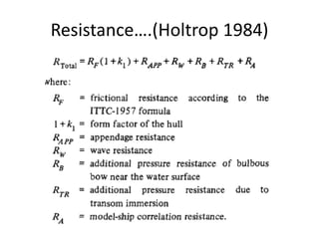
Resistance & Power Calculations
Holtrop & Mennen’s Method

Slide 19
Resistance & Power Calculations (contd.)
Resistance Summary
Frictional Resistance | R_{F} | 28.489 | kN
Resistance of Appendages | R_{APP} | 5.923 | kN
Wave Making and Wave Breaking Resistance | R_{W} | 15.896 | kN
Additional Resistance due to Bulbous Bow | R(B) | 0 | kN
Resistance of Immersed Transom Stern | R(TR) | 0.25 | kN
Model Ship Correlation Resistance | R_{A} | 8.428 | kN
Total Resistance | R_{T} | 58.381 | kN

Slide 20
Resistance & Power Calculations (contd.)
Power Summary
Effective Power | 300.312 | kW
ηo | 0.55
ηd (QPC) | 0.534
Delivered Power | 562.569 | kW
Shaft Power (considering shaft loss of 3.5%) | 582.974 | kW
Power (considering gear box loss of 5%) | 613.656 | kW
Power (considering sea margin of 15%) | 705.704 | kW
Total Brake Power (considering 85% MCR) | 830.241 | kW
Per Engine Brake Power | 415.121 | kW

Slide 21
Rudder Design & Steering Arrangement
Scantling Summary (Rudder) (DNV – GL 2016)
Used Material | HLS GL F-40
Rudder Area (each) | 2.557 | m²
Mean height | 1.872 | m
Mean breadth | 1.366 | m
Aspect ratio | 1.371
Rudder Force | 41.71 | kN (ahead)
 | 10.92 | kN (astern)
Rudder Torque | 5.696 | kNm (ahead)
 | 6.115 | kNm (astern)
Rudder Stock Diameter | 70 | mm
Coupling Bolt Diameter | 20 | mm
Coupling Flange Thickness | 20 | mm
Rudder Plate Thickness | 8 | mm
Rudder Web Thickness | 7 | mm
Pintle Diameter | 84 | mm
Bearing liners | 8 | mm
NACA Section | 0010

Slide 22
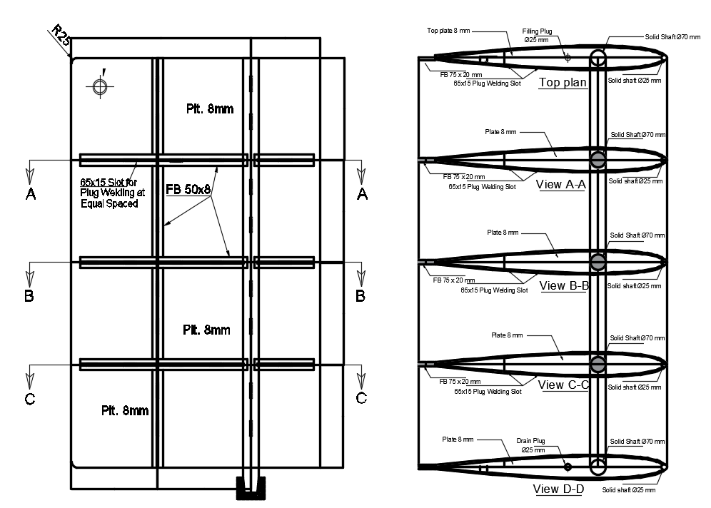
Rudder Design & Steering Arrangement (contd.)
Rudder Drawing

Slide 23
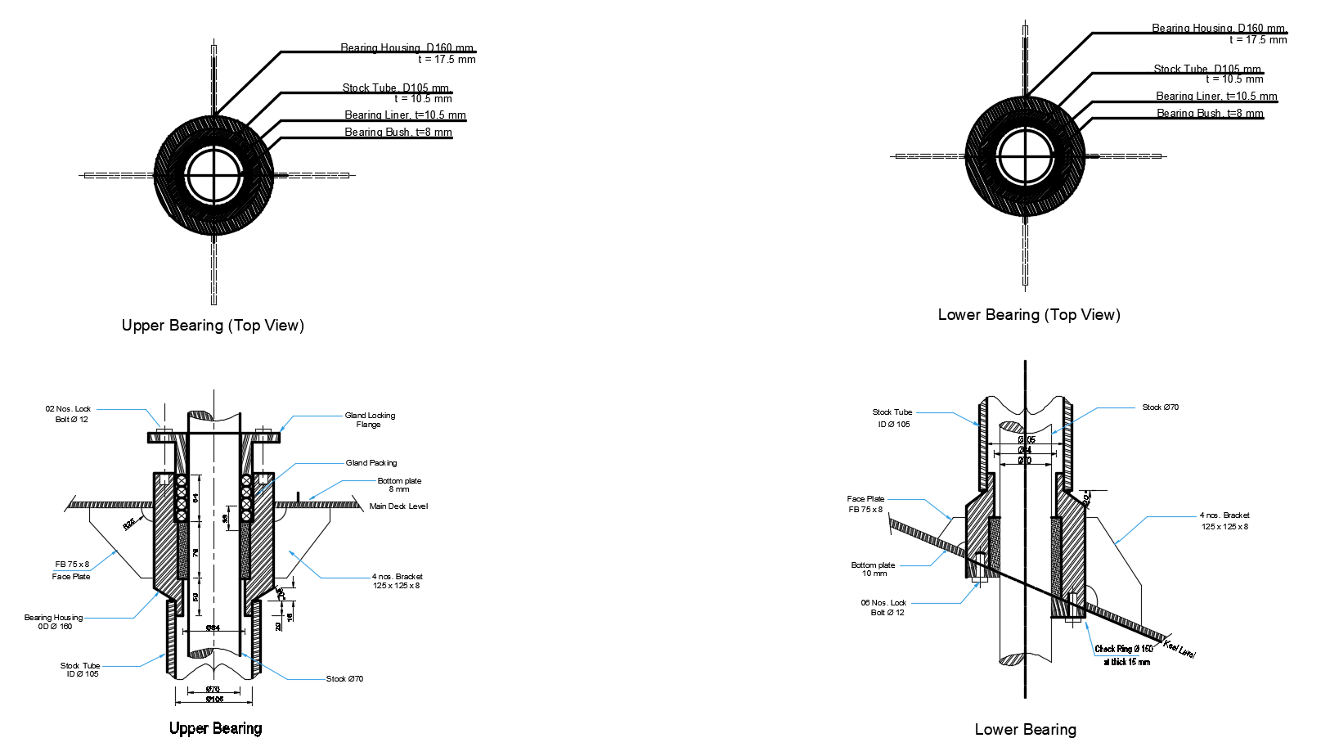
Rudder Design & Steering Arrangement (contd.)
Rudder Drawing

Slide 24
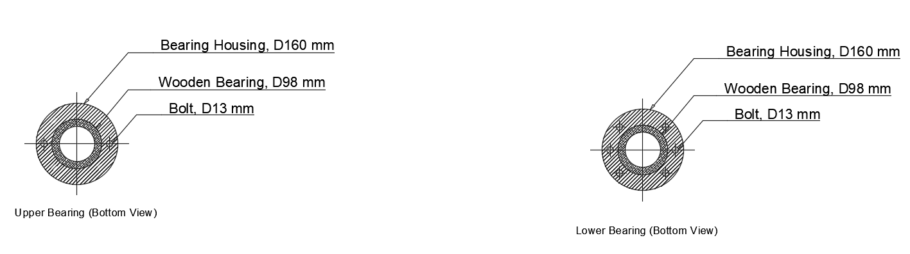
Rudder Design & Steering Arrangement (contd.)
Rudder Drawing

Slide 25
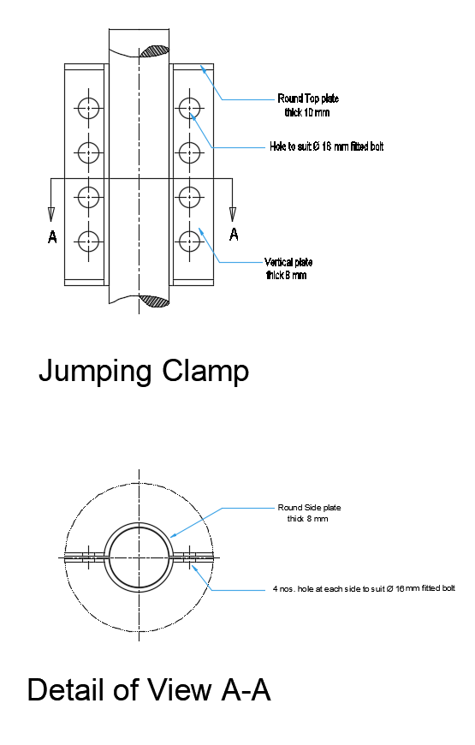
Rudder Design & Steering Arrangement (contd.)
Rudder Drawing

Slide 26
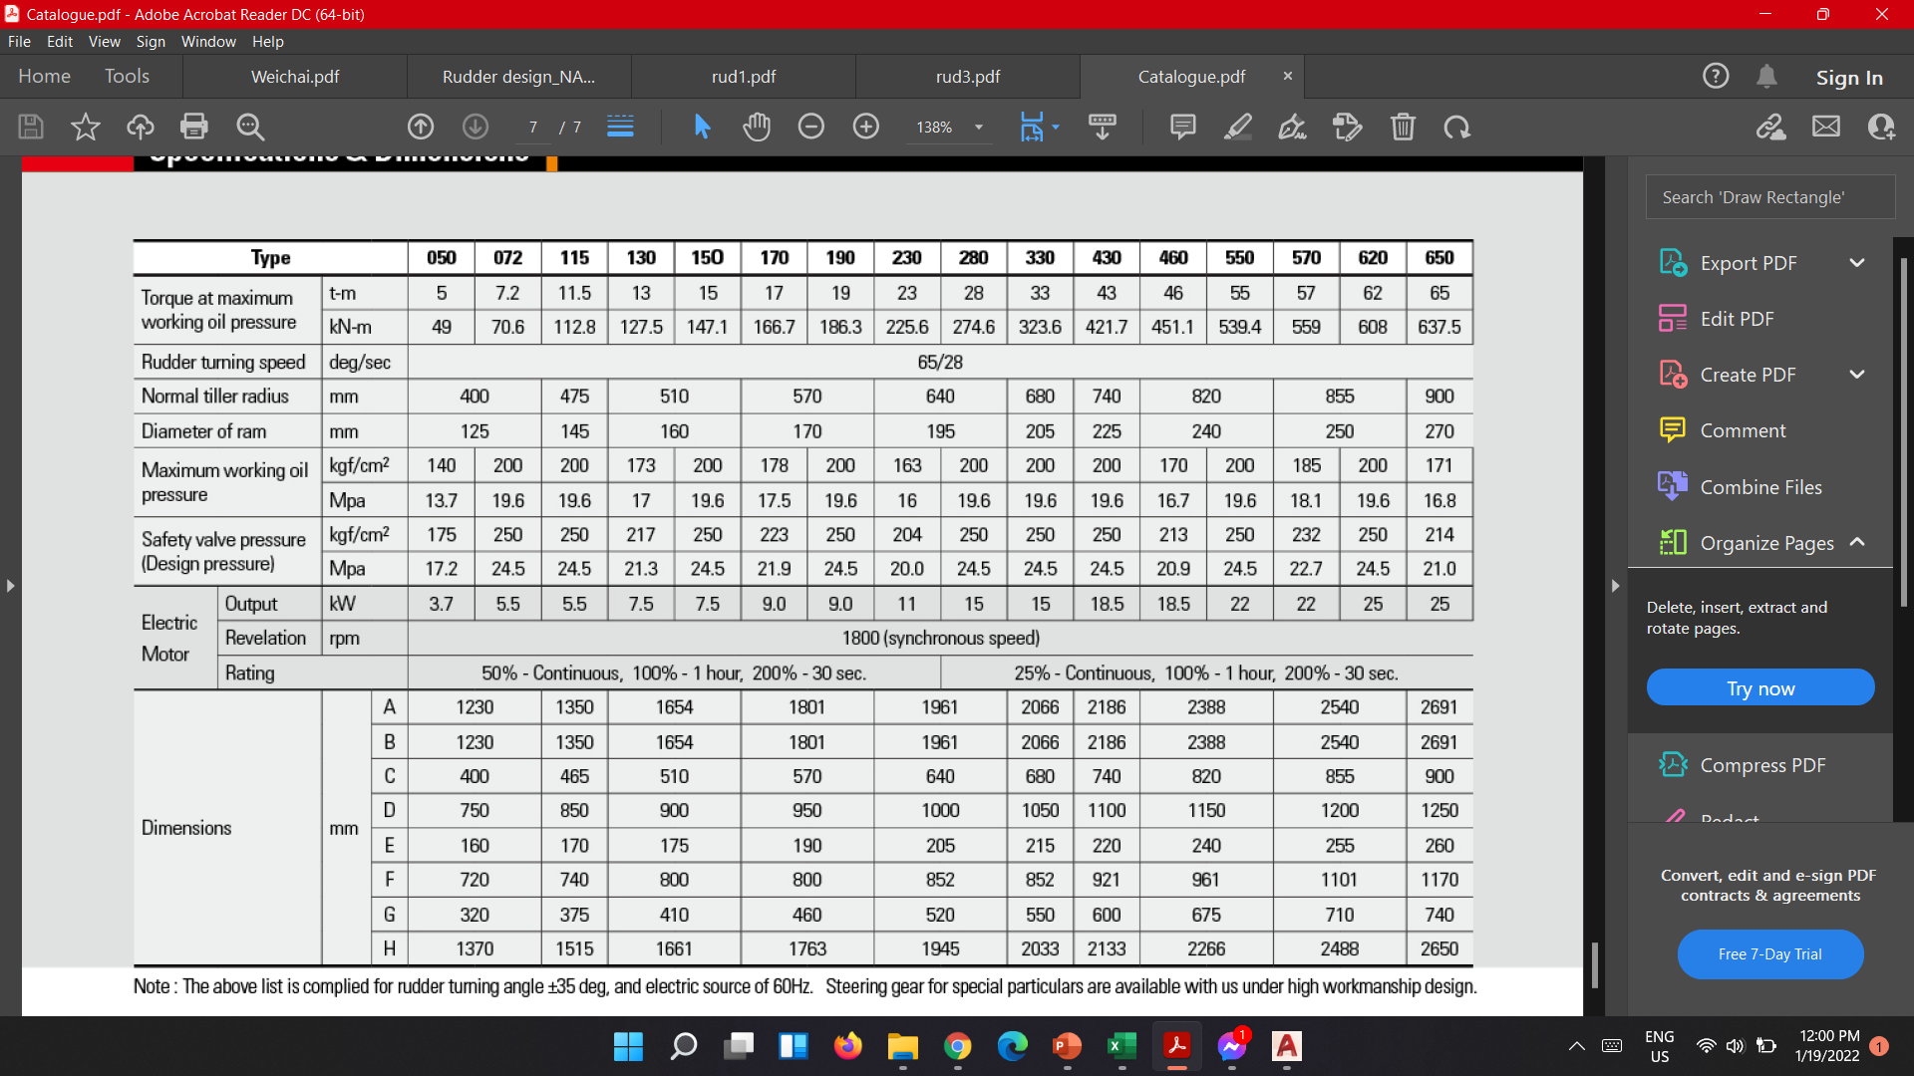
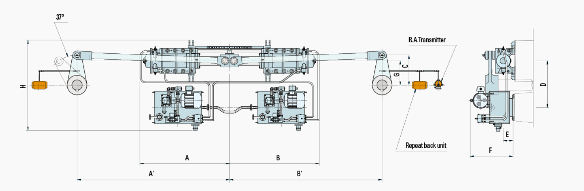
Rudder Design & Steering Arrangement (contd.)
Steering Gear

Slide 27
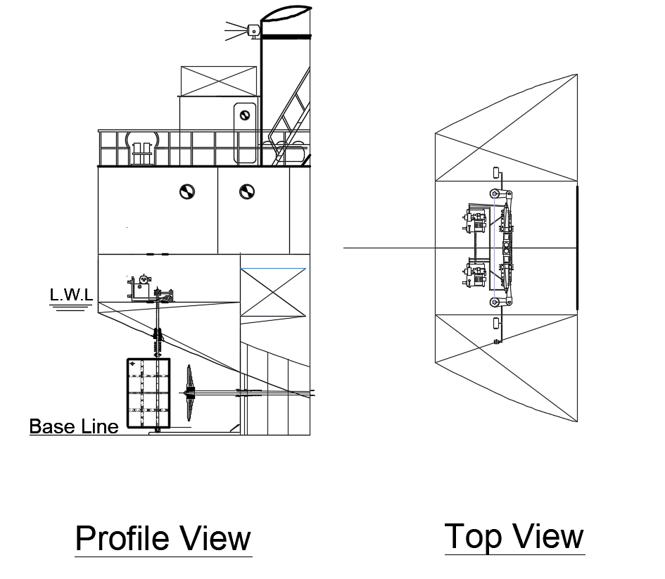
Rudder Design & Steering Arrangement (contd.)
Steering Gear

Slide 28
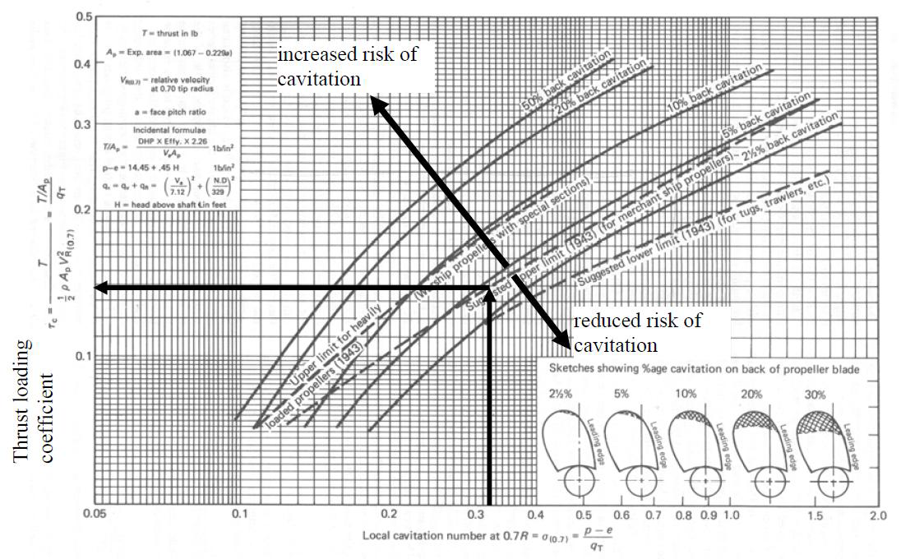
Propeller Design
Cavitation Check
BAR | 0.65
Open water efficiency | 0.55
P/D | 0.91
J | 0.51
Min. BAR (for cavitation) | 0.598

Slide 29
Propeller Design (contd.)
Propeller Parameters
Number of propellers | 2
Number of blades | 3
BAR | 0.65
Diameter, D | 1.533 | m
P/D | 0.91
Efficiency | 0.55
Propeller speed | 327 | rpm
Pitch, P | 1.395 | m

Slide 30
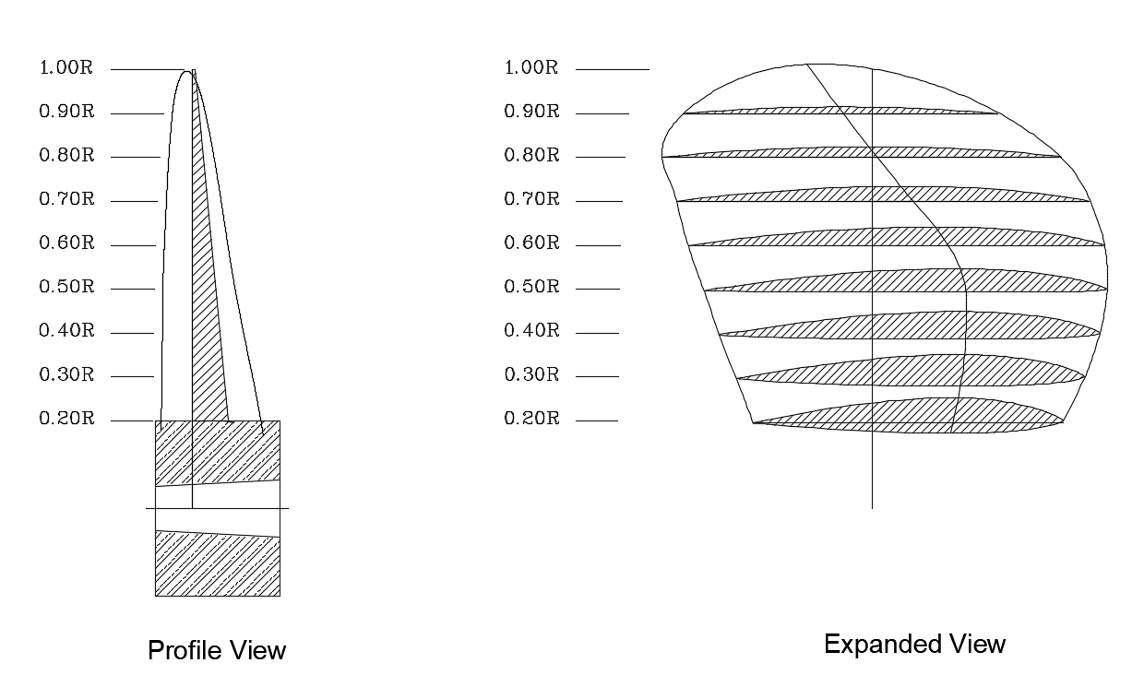
Propeller Design (contd.)
Propeller Drawing

Slide 31
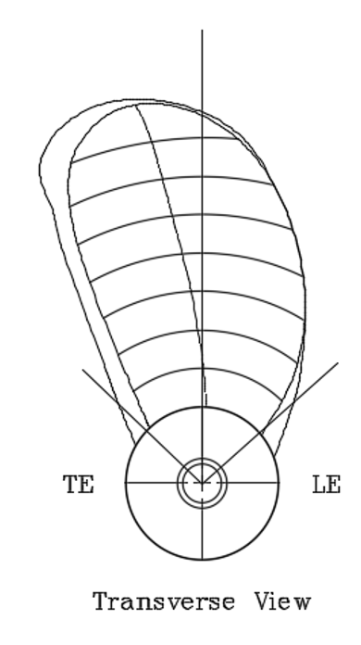
Propeller Design (contd.)
Propeller Drawing

Slide 32
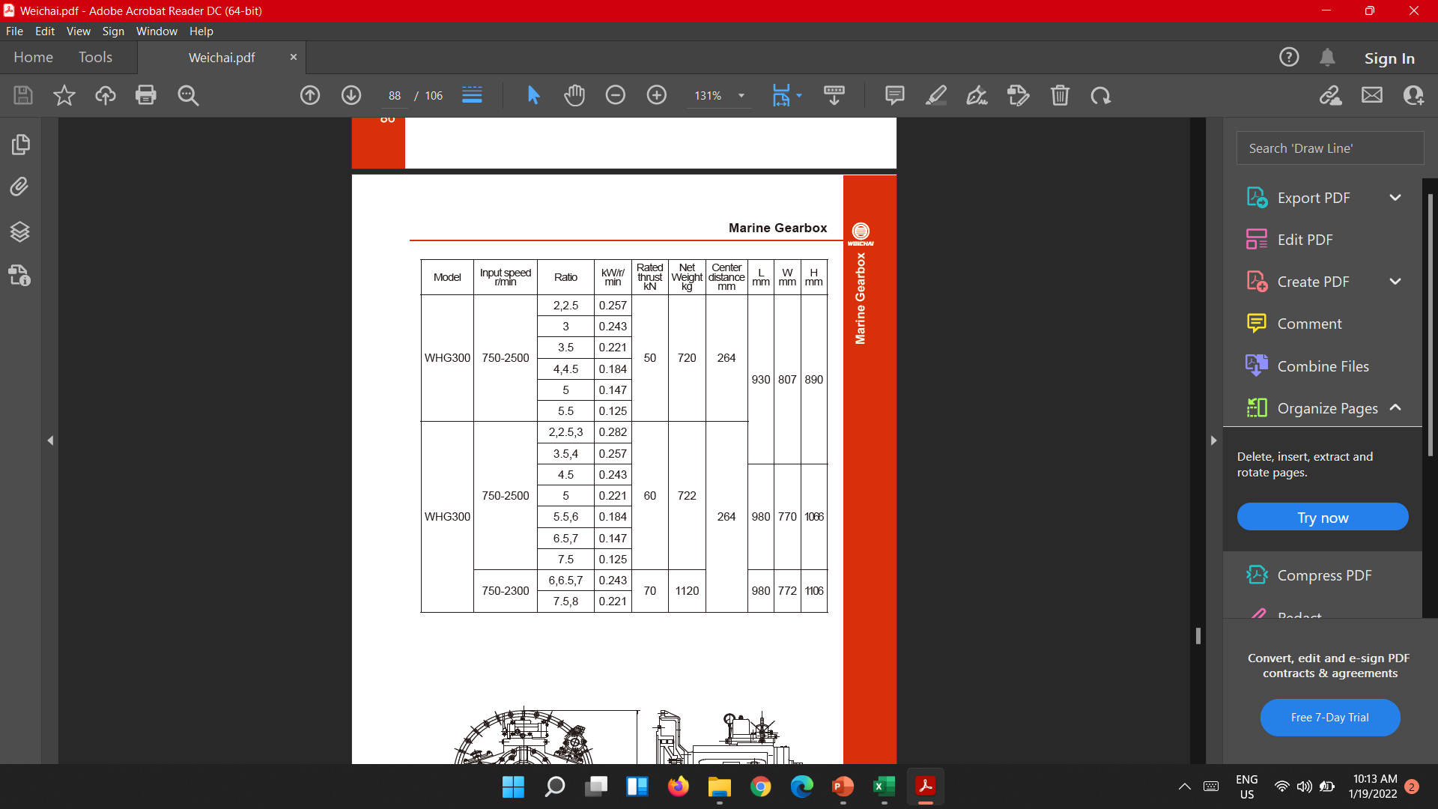
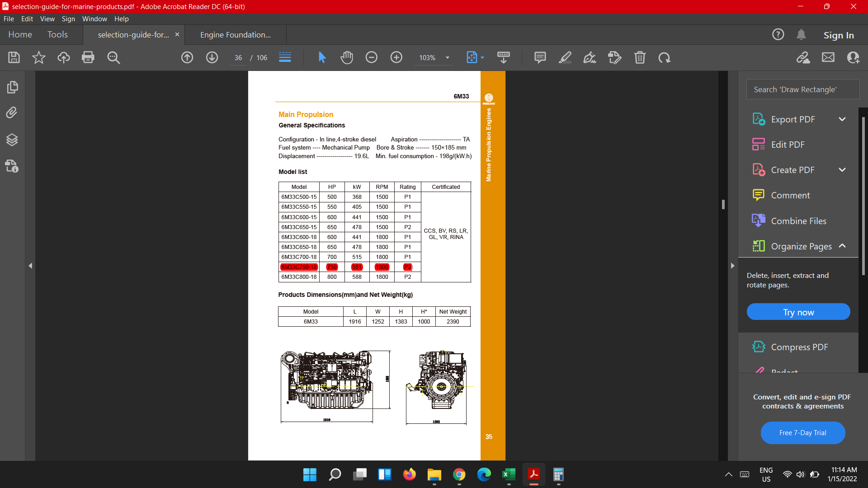
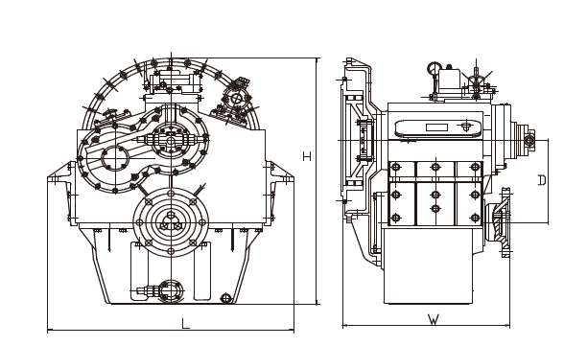
Engine Selection & Design of Engine Foundation
Selection of Engine and Gear Box
Model | HP | KW | RPM | Rating | Certified By
6M33C750-18 | 649 | 484 | 1800 | P1 | CCS, BV, RS, LR, GL, VR, RINA

Slide 33
Engine Selection & Design of Engine Foundation (contd.)
Scantling Summary (Engine Room) (DNV – GL 2016)
Plate Floor | 8 | mm
Longitudinal Girder | 8 | mm
Side Girder | 8 | mm
Inner Bottom Plate | 7 | mm
Top Plate (Thickness) | 23 | mm
Top Plate (Width) | 270 | mm
Bottom Plate | 10 | mm
Web Frame | T-200x100x12 | mm
Foundation Bolt (Diameter) | 3 | mm
Foundation Bolt (Spacing) | 70 | mm

Slide 34
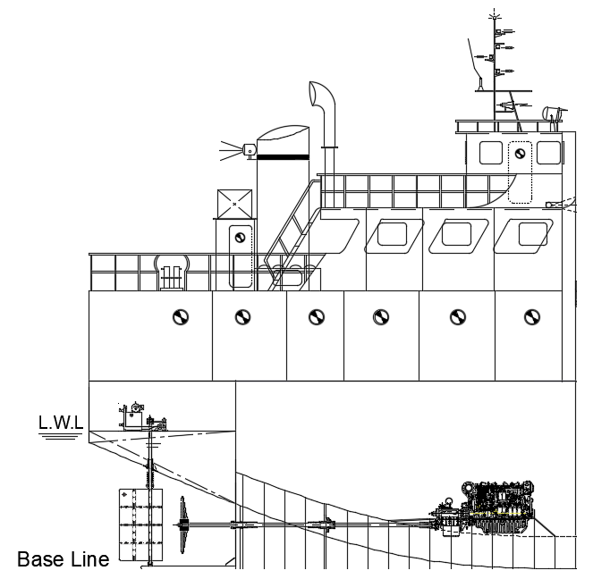
Engine Selection & Design of Engine Foundation (contd.)
Profile View

Slide 35
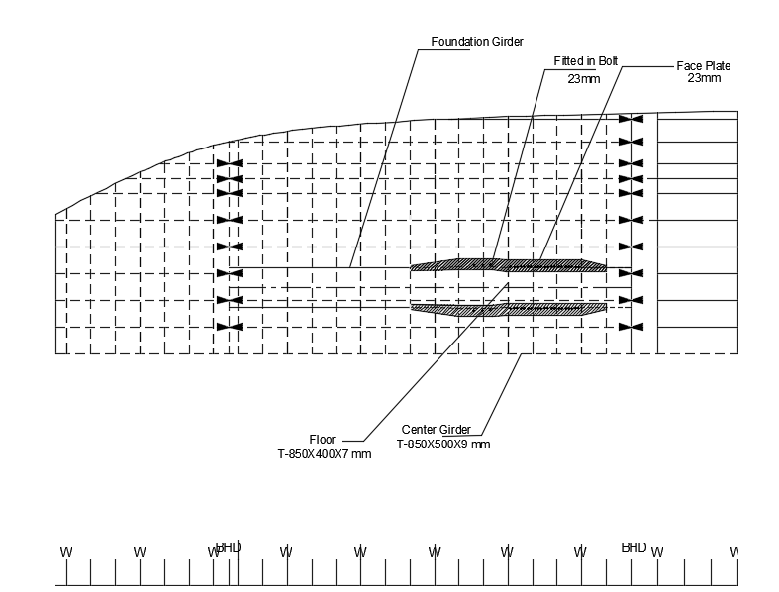
Engine Selection & Design of Engine Foundation (contd.)
Plan View

Slide 36
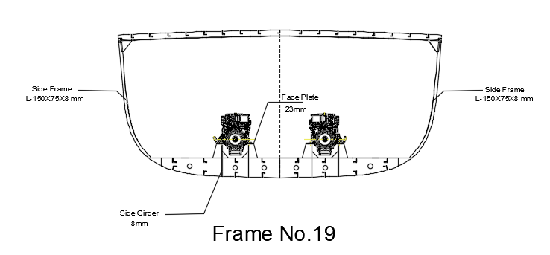
Engine Selection & Design of Engine Foundation (contd.)

Slide 37
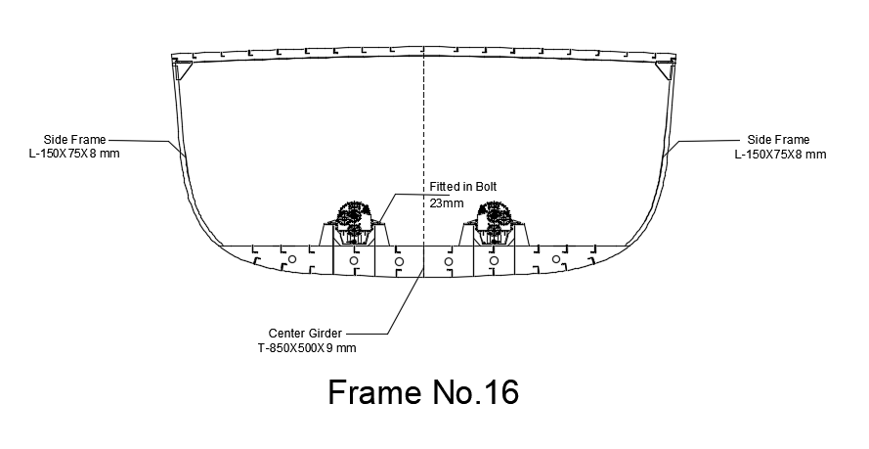
Engine Selection & Design of Engine Foundation (contd.)

Slide 38
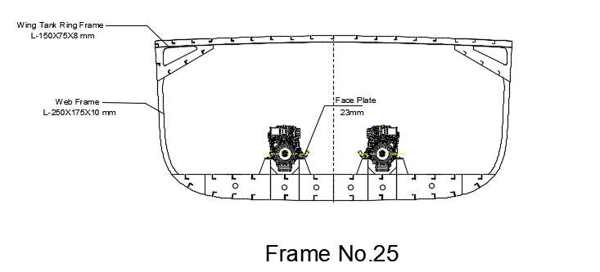
Engine Selection & Design of Engine Foundation (contd.)

Slide 39
Engine Selection & Design of Engine Foundation (contd.)
Shafting Arrangement Summary
Shaft Speed | 327 | rpm
Torque | 16 | kNm
Stress | 120 | Nm^-2
Shaft Diameter | 100 | mm
Twisting angle | 4.75 | degrees
Shaft liners | 6 | mm
Coupling | 18 | mm
Shaft bearing max. distance | 2.6 | m
Stern tube bearing (fwd.) | 90 | mm
Stern tube bearing (aft) | 220 | mm
Flange coupling bolt diameter | 38 | mm

Slide 40
Engine Selection & Design of Engine Foundation (contd.)
Shafting Arrangement Summary
SL. NO | DESCRIPTION | MATERIALS | NUMBER OF COMPONENT
1 | Cone nut | M.B. BS | 1
2 | Cone nut securing screw | M.B. BS | 2
3 | Propeller key | M.B. BS | 1
4 | Propeller dia X pitch | M.B. BS | 1
5 | Aft Brg securing screw | M.B. BS | 3
6 | Cover plate securing screw | STEEL BS | 3
7 | Aft locking ring | STEEL BS | 1
8 | Cover plate | STEEL BS | 1
9 | Lock ring securing screw | STEEL BS | 3
10 | FWD locking ring | STEEL BS | 1
11 | Rubber bearing
12 | Sterntube | STEEL BS | 1
13 | Tailshaft |  | 1
14 | gland housing | G.M. BS | 1
15 | FWD bearing | G.M. BS | 1
16 | Greasy packing | GRAPHITED ASBESTOS | 3 turns
17 | Gland ring | G.M. BS | 1
18 | Gland studs and nuts | M.B. BS | 2
19 | Coupling key | STEEL BS | 1
20 | Half coupling | STEEL BS | 1
21 | Backing washer | STEEL BS | 1
22 | Locking nut | STEEL En7 BS | 1
23 | Sealing ring | BS | 1
24 | Fwd brg securing screw | M.B. BS | 1
25 | Bearing lock ring | STEEL BS | 1

Slide 41
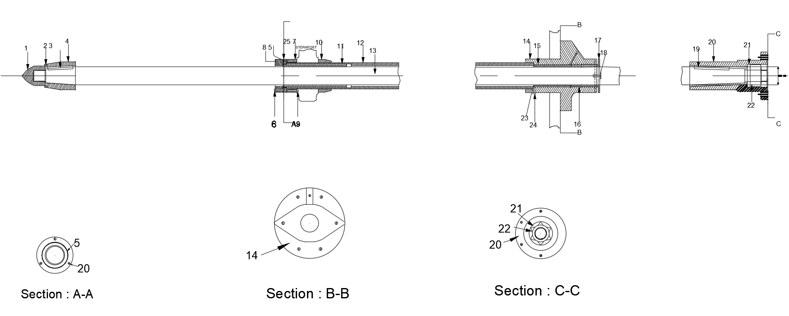
Engine Selection & Design of Engine Foundation (contd.)
Shafting Arrangement Drawing

Slide 42
Thank You.

